Slide 1
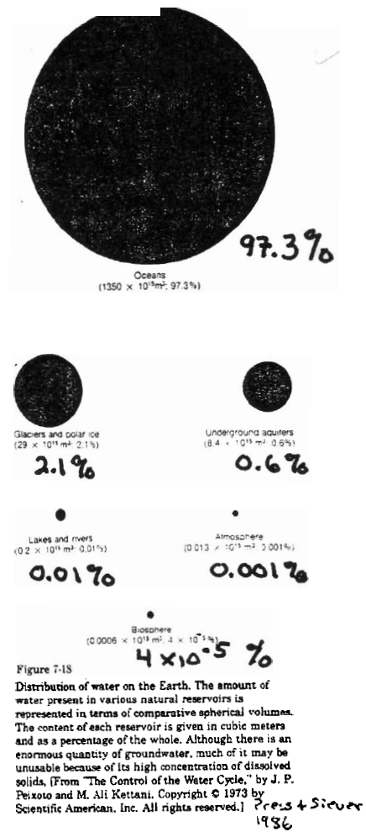
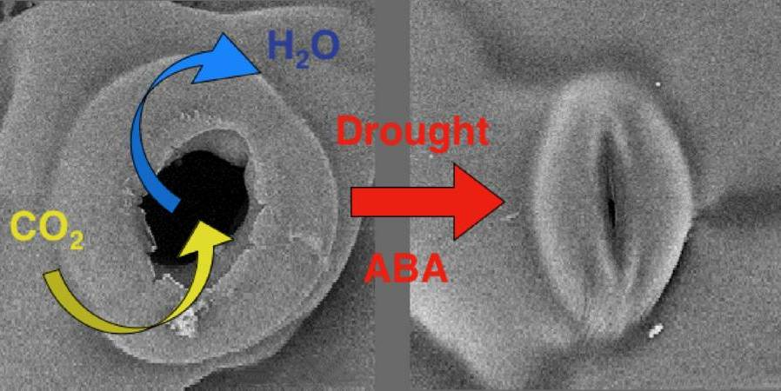
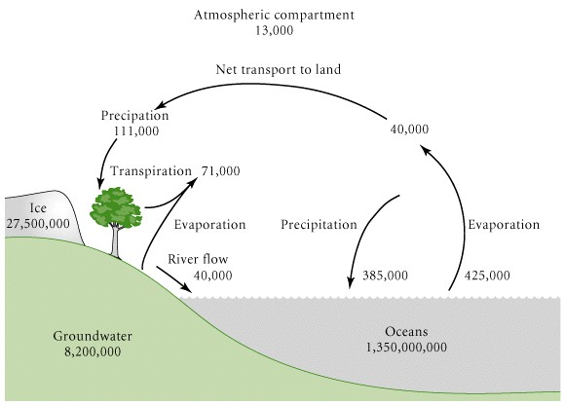
Ricklefs & Miller 2000 from Schlesinger 1991
Pools = km³
Flows = km³/yr

Slide 2
Hydrologic Cycle
(water)
Processes:
  Precipitation
  Evaporation
  Transpiration - evaporation from leaves
  Runoff
Fluxes
  Oceans - E > P ∴ net transport of vapor to land
  Land - ET < P ∴ net runoff to ocean (ca. 1/3 of P = R)

Slide 3
Mean Residence Time
(pg. 154 in textbook)
For a system in dynamic equilibrium:
Mean Residence Time (τ) = stock / inflow or outflow
10 L/sec
10 L/sec
100 L
τ = 100 L / 10 L/sec = 10 sec
τ = Average length of time a given atom or molecule spends in the system between entering and leaving.
What is τ for the entire ocean?
What is τ for the entire water vapor in the atmosphere?

Slide 4
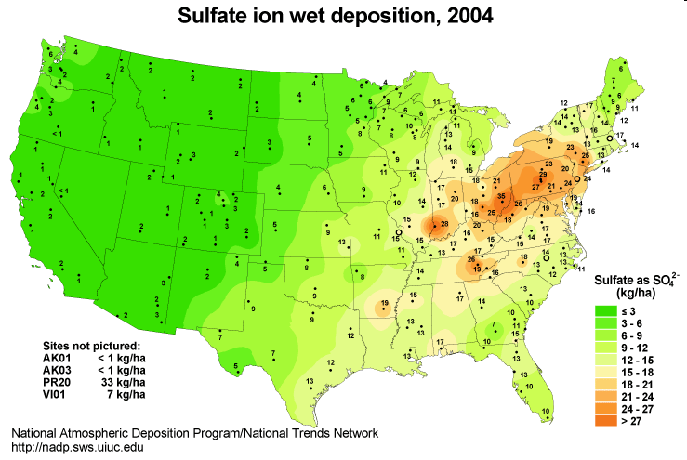
Why do you think sulfur in WV coal that’s burned upwind in Ohio, returns to WV as sulfuric acid in acid rain?

Slide 5
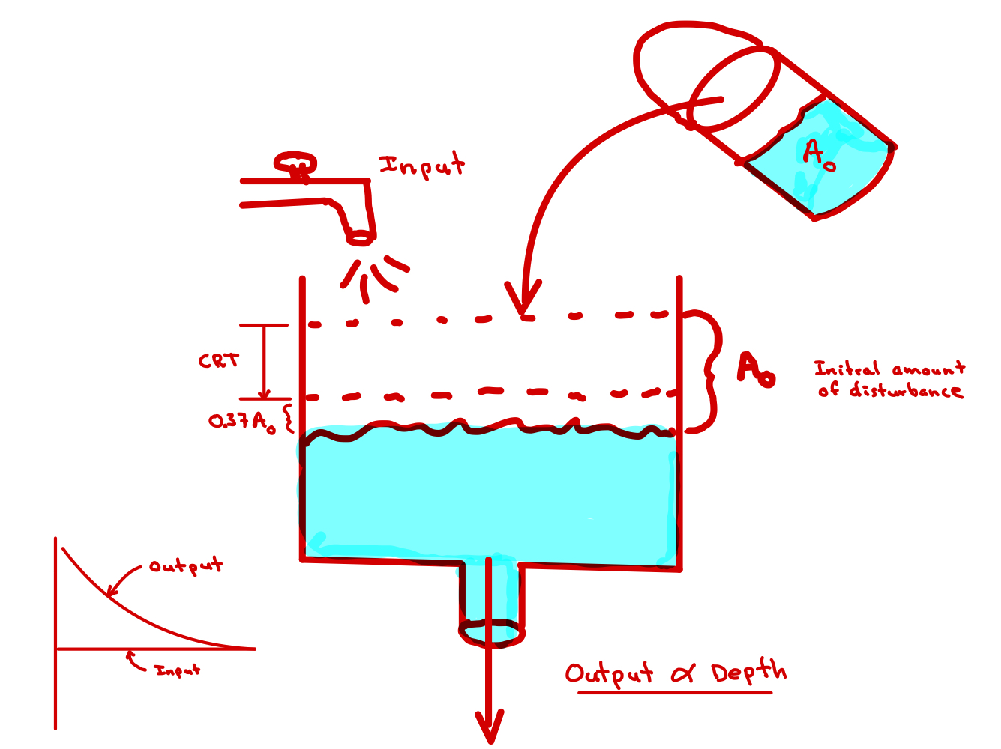
Also
= the Characteristic Response Time for a system responding to a large imbalance in inflow and outflows.
(pg. 154 textbook)
More precisely …
If removal rate is proportional to size the amount of material in the system, then the CRT is the time it takes for the amount of material in a system to decrease to ~37% of its original size when steady state is disturbed such that the outflow rate exceeds the inflow rate and the outflow depends on the amount of material in the system.
If removal rate is proportional to size the amount of material in the system, then the system behaves in a manner similar to radioactive decay.
A_{t} = A₀*e^{-kt} where: A = amount in system; t = time; k = 1/τ
0.37A₀= A₀*e^{-kt}
(1/e)A₀ = A₀*e^{-kt} note: (1/e) = 0.37 or 37%
e⁻¹ = e^{-kt}
-1 = -kt
t = 1/k = τ

Slide 6
Regional Variability in the Hydrologic Cycle
E_{Ocean} ~ 4 mm/day in tropics
< 1mm/day near poles
P_{land} > 250 cm/yr Rainforests
< 25 cm/yr Deserts
Net P = (P – ET)
Highest near equator
Lowest in subtropics
P >> ET in tropical rainforests
R_{tropics} ~ 0.5 P
P ~ ET in deserts
Sources of P
P_{ocean} ➔ E_{ocean}
P_{land} Monsoonal climate → E_{ocean}
Amazon rainforest → ~ 0.5P from ET_{Amazon}

Slide 8
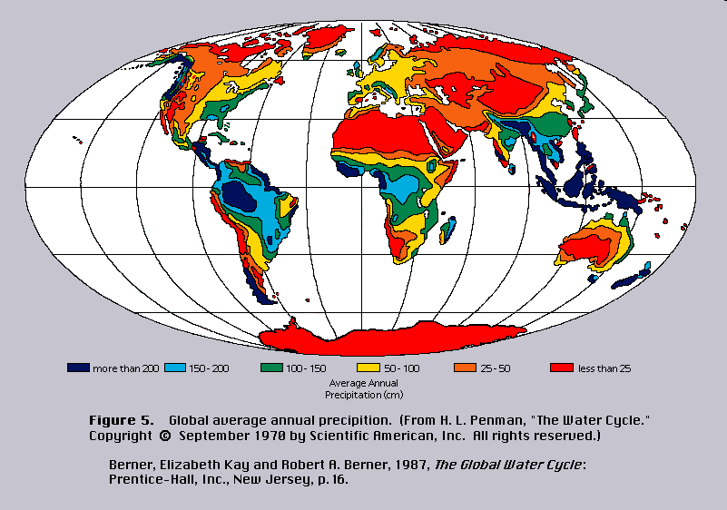
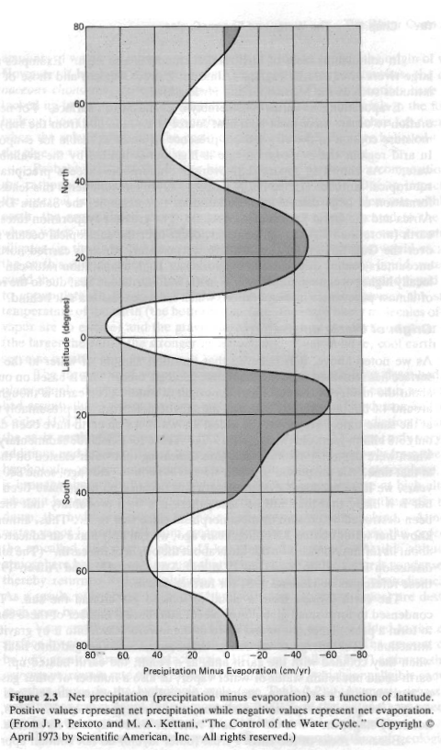
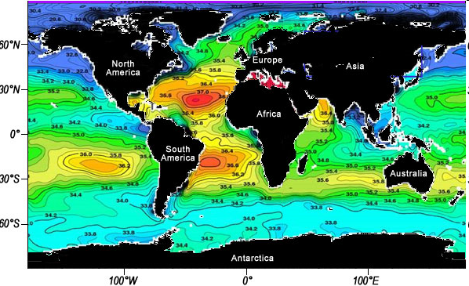
Berner & Berner 1987
Notes:
Salinity graph from http://aquarius.nasa.gov/education-salinity.php

Slide 9
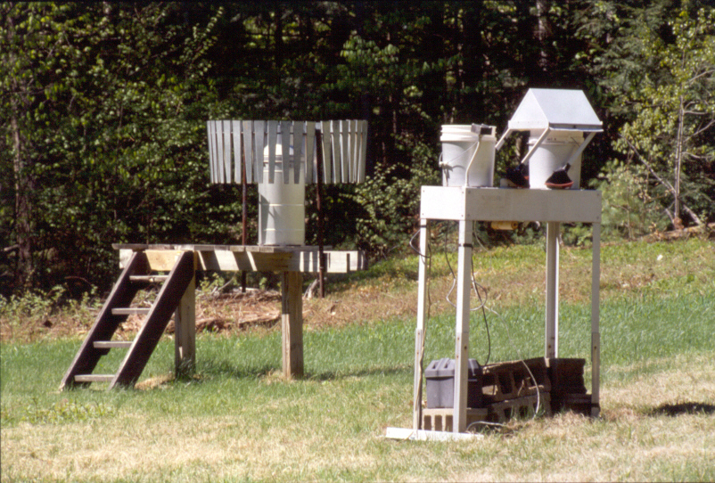
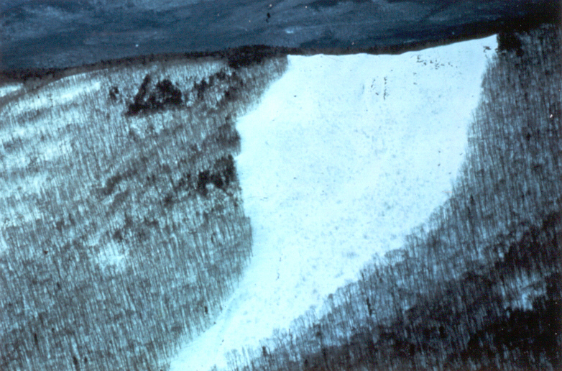
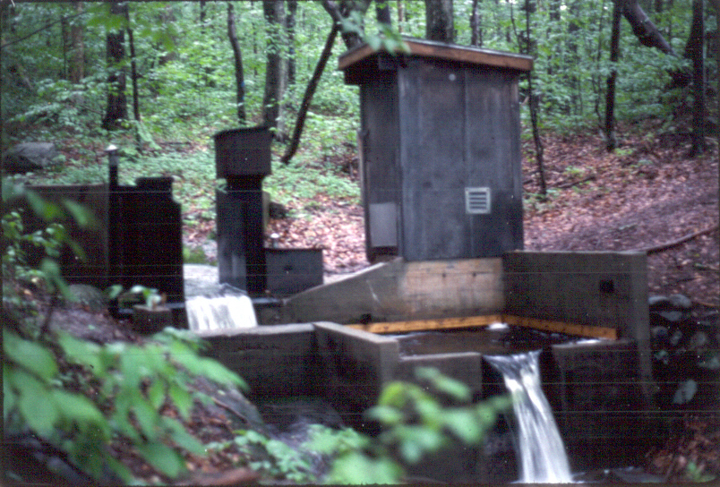
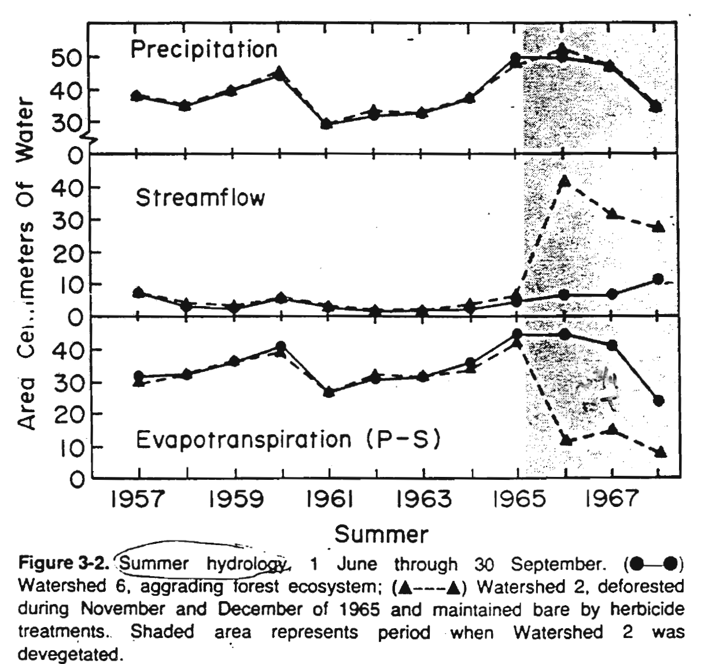
Paired Watershed Experiments
Bormann & Likens 1981
Notes:
http://www.hubbardbrook.org/image_library/index.php

Slide 10
Fernow Experimental Forest
Parsons, WV
Aber & Melillo 1991
Swank & Douglas 1977

Slide 11
Recent changes in the hydrologic cycle.
=======================
Streamflow has increased globally by 3% during the last
65 years
Precipitation on land has increased globally by 1% during the last 100 years.
=======================
What fraction of the increased streamflow could be due to the increase in precipitation?
Since R_{ocean} = 40, 000 km³/yr, then
R_{ocean} has increased at a rate of 1,200 km³/65 years = 18.4 km³/yr
Since P_{land} = 111,000 km³/yr, then
P_{land} had increased at a rate of 1,110 km³/100 yrs = 11 km³/yr
Of the increased runoff to the Ocean, at most ~ 60% (11/18.4*100) can be explained by the increased amount of precipitation over land.
This would leave at least 40% of the increased due to other factors.
Notes:
http://www.shef.ac.uk/aps/mbiolsci/hungerford-dan/background.html
http://www.scienceclarified.com/Io-Ma/Leaf.html
http://www.isv.cnrs-gif.fr/jg/themegb.html

Slide 12
PNAS 2007

Slide 13
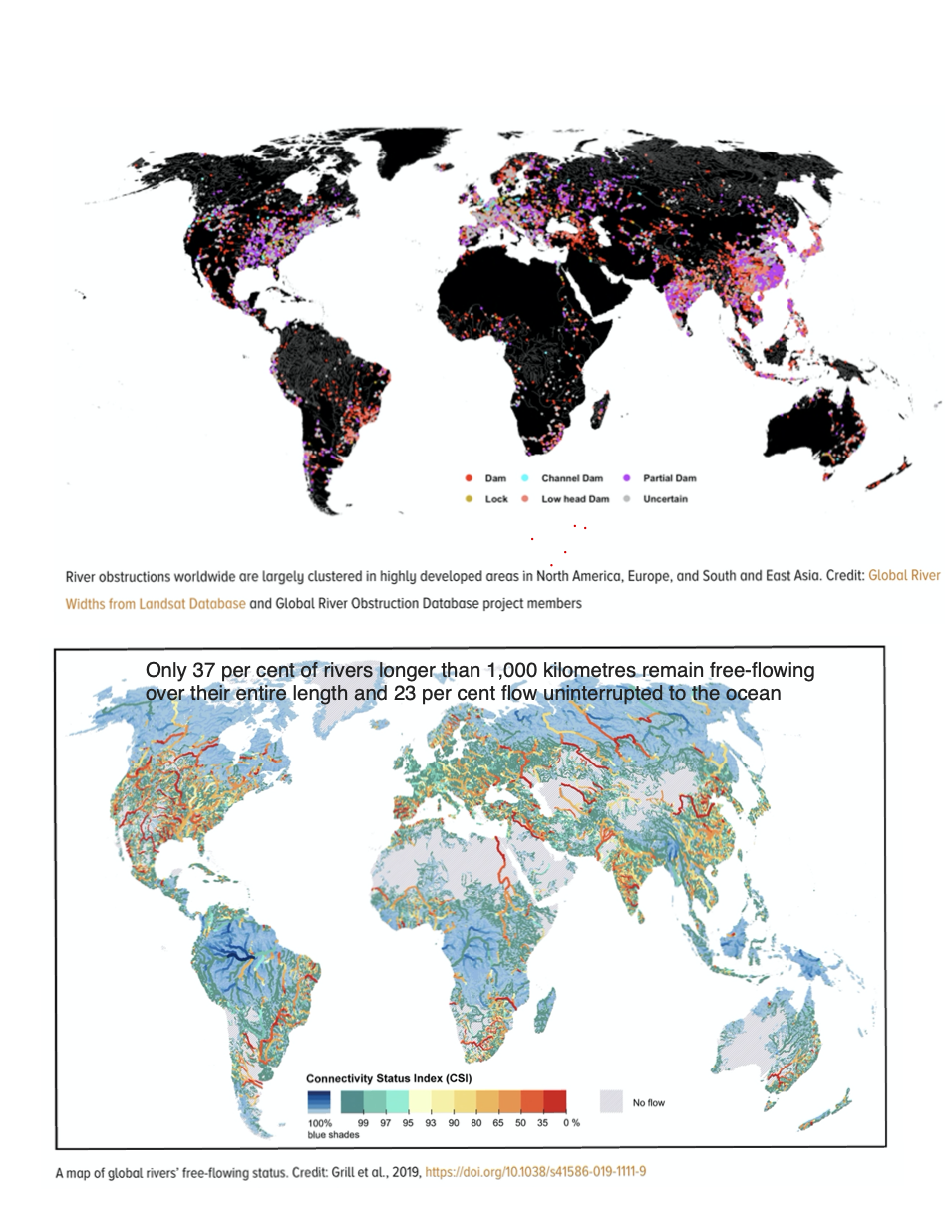
Humans appropriate >50% of the accessible freshwater on Earth

Slide 14
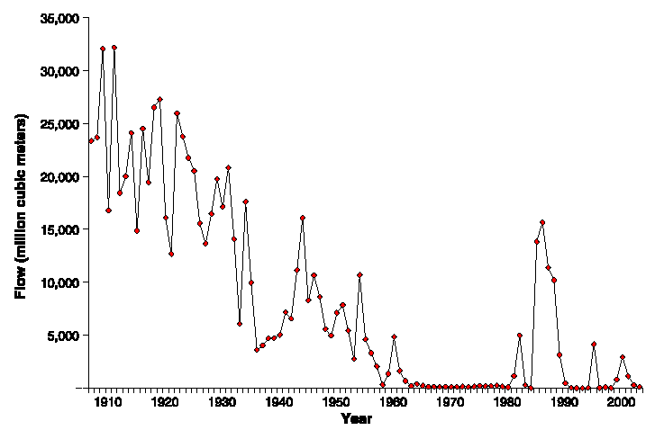
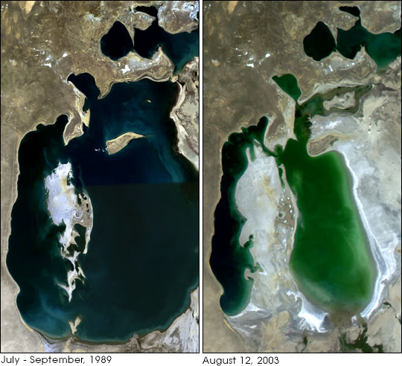
Change in flow of Colorado River
From 1973 to 1987 the Aral dropped from the 4th to the 6th among the world’s largest lakes.
Notes:
Fig. 1. Colorado river flows below all major dams and diversions, 1905 to 2001. Data are flows of the Colorado River as measured at U.S. Geological Survey Gage 09-5222, 35 km downstream from Morelos Dam. As shown, flows reaching the Colorado River delta have dropped to near zero in most years.
From: Gleick, P.H. 2003 Science 28 NOVEMBER 2003 VOL 302 Pg. 1524
For more than 30 years, water has been diverted from the Amu-Darya and the Syr-Darya Rivers feeding the Aral, to irrigate millions of acres of land for cotton and rice production in Central Asia. This has caused a loss of more than 60% of the lake's water. The lake has shrunk from over 65,000 sq km to less than half that size, exposing large areas of the lake bed.
From 1973 to 1987 the Aral dropped from fourth to sixth among the world's largest lakes.
The lake's salt concentration increased from 10% to more than 23%, contributing to the devastation of a once thriving fishery. The local climate has reportedly shifted, with hotter, drier summers and colder, longer winters.
http://www.nationalgeographic.com/xpeditions/activities/14/aral.html
http://ceos.cnes.fr:8100/cdrom-98/ceos1/casestud/fdb/aral1.htm
http://nl.wikipedia.org/wiki/Aralmeer

Slide 15
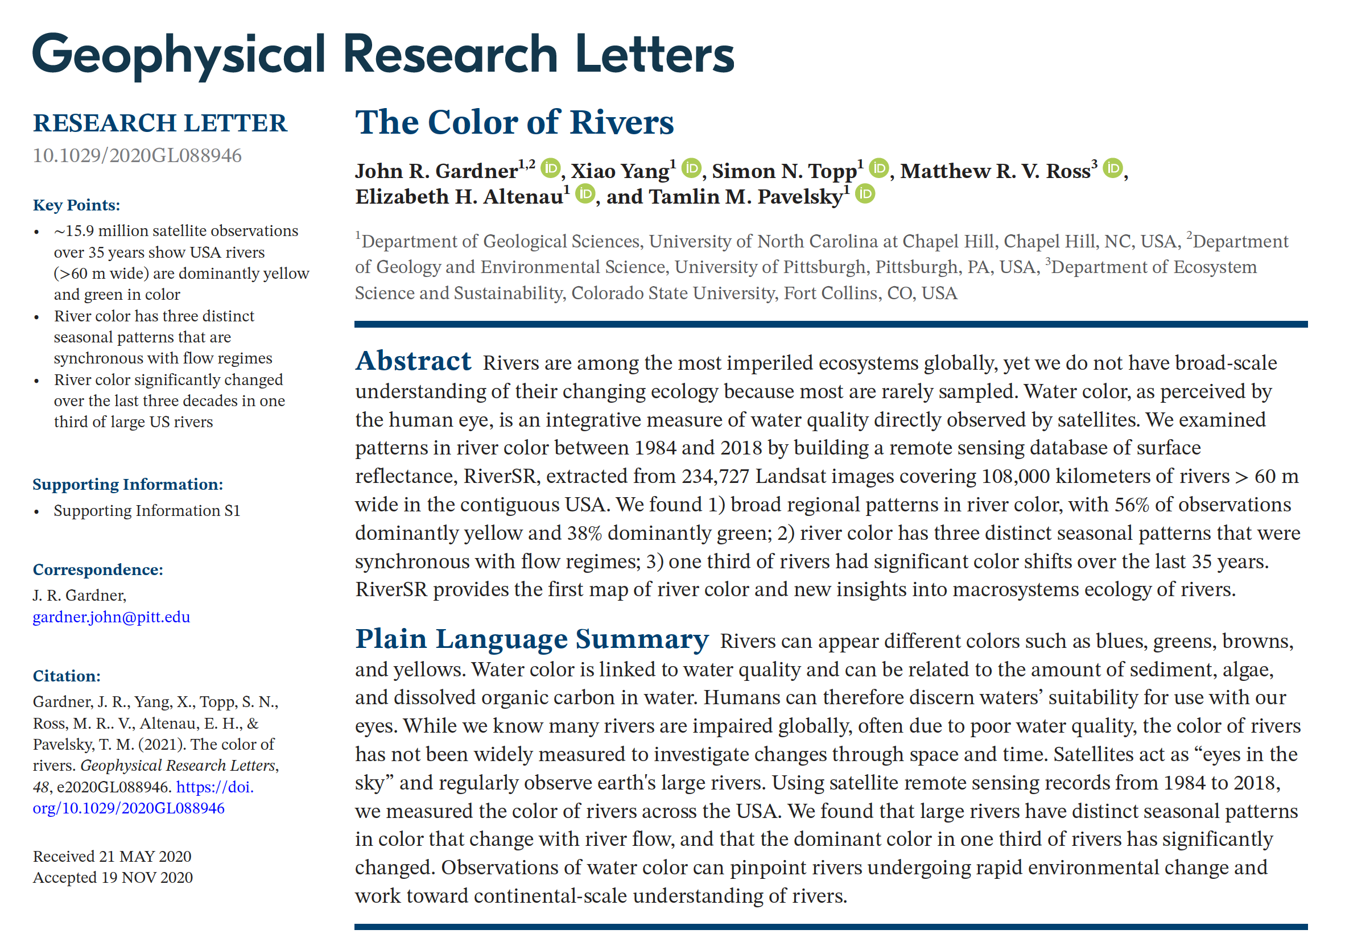
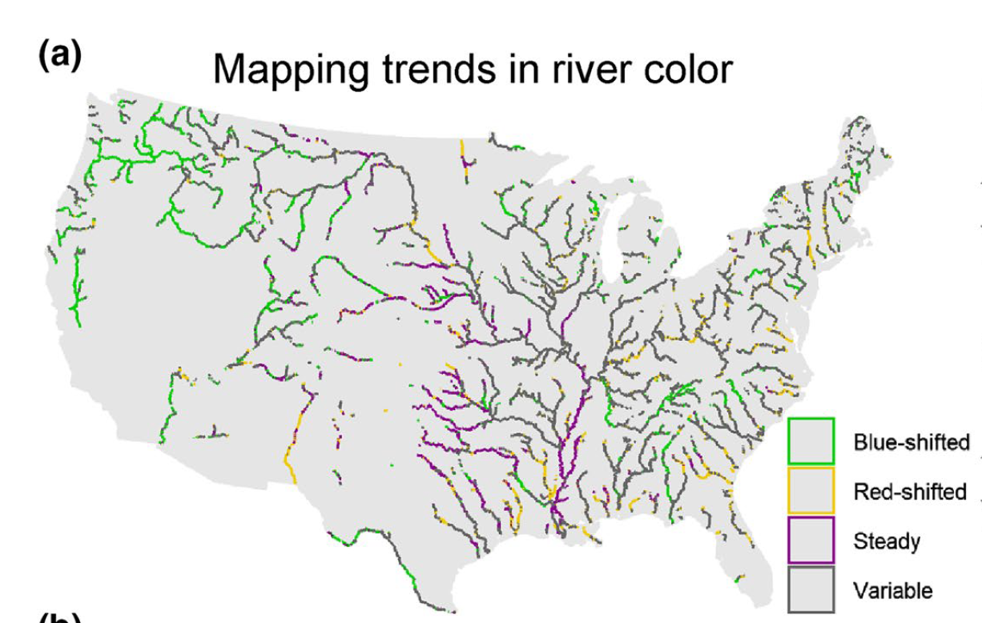
In the east, the reflectance of these rivers shifted to yellowish-red wavelengths, indicating a greater load of suspended sediments. In the west, the reflectance of rivers has shifted to the blue-green end of the spectrum, perhaps as a result of a proliferation of dams that slow the flow of rivers and allow sediments to settle out.
Schlesinger 2021
Translational Ecology
https://blogs.nicholas.duke.edu/citizenscientist/the-source-of-the-yellow-river/

Slide 16
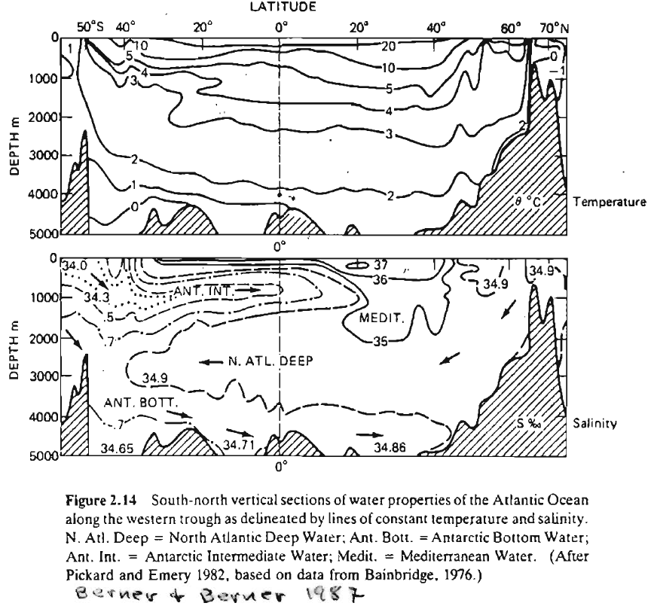
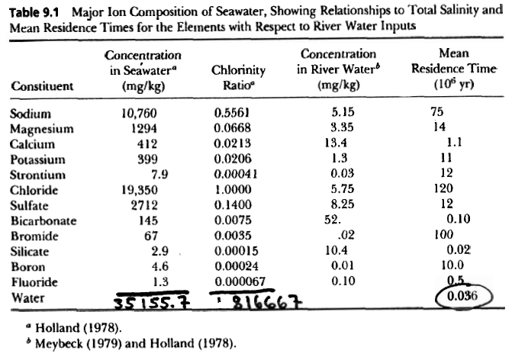
1.

Slide 17
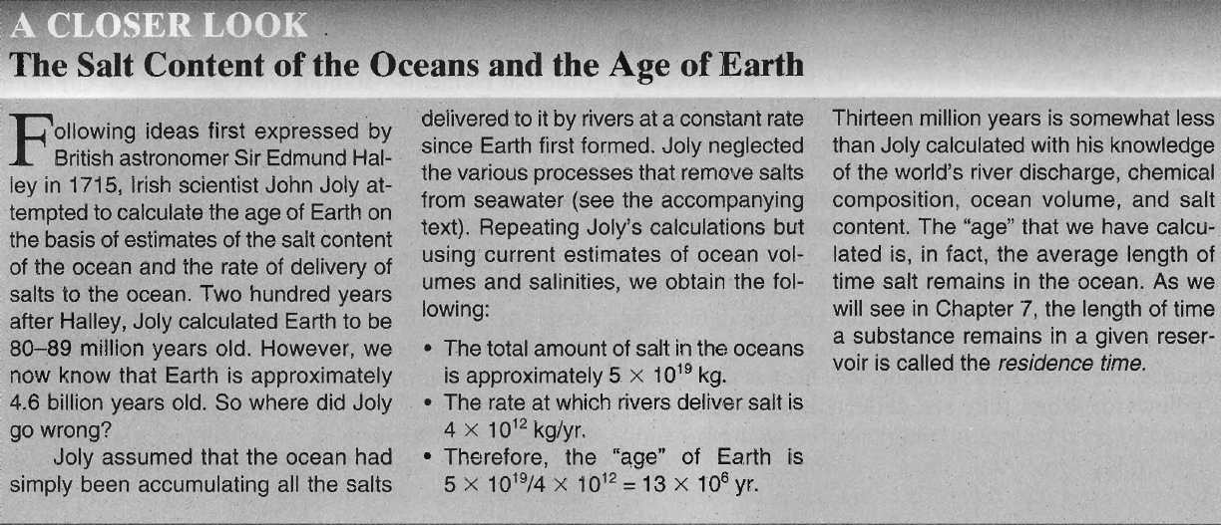
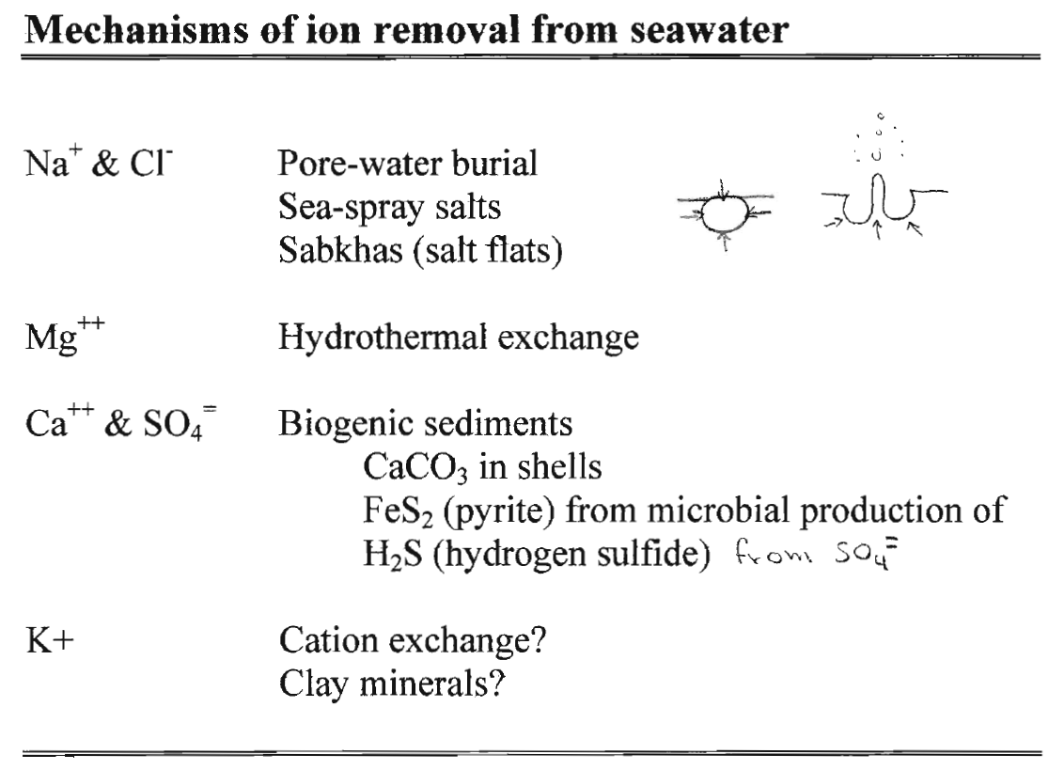
Kump et al. 2004

Slide 18
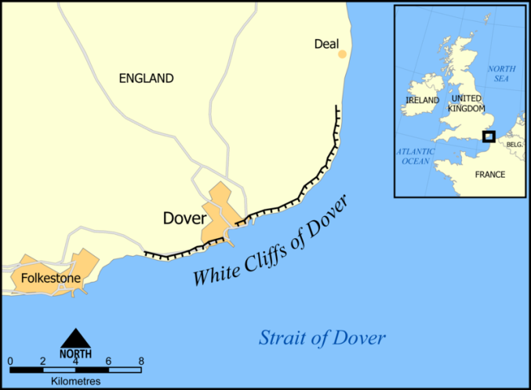
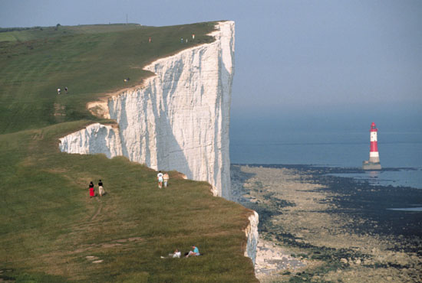
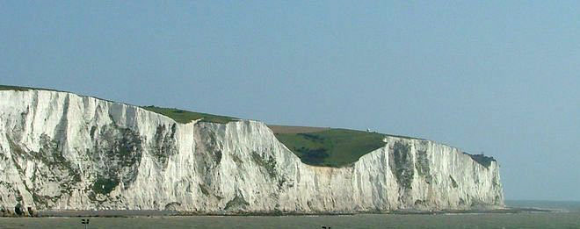
White cliffs of Dover
Notes:
http://mkeamy.typepad.com/.a/6a00d8357a52bc69e2010536a6327c970c-popup
Wikipedia:
The cliff face, which reaches up to 107 metres (351 ft),^{[1]} owes its striking façade to its composition of chalk (pure white calcium carbonate) accentuated by streaks of black flint.
The cliffs are composed mainly of soft, white chalk with a very fine-grained texture, composed primarily of coccoliths, plates of calcium carbonate formed by coccolithophores, single-celled planktonic algae whose skeletal remains sank to the bottom of the ocean and, together with the remains of bottom-living creatures, formed sediments. Flint and quartz are also found in the chalk.^{[2]}
Limestone is a sedimentary rock composed largely of the mineral calcite (calcium carbonate: CaCO₃). Like most other sedimentary rocks, limestones are composed of grains; however, most grains in limestone are skeletal fragments of marine organisms such as coral or foraminifera. Other carbonate grains comprising limestones are ooids, peloids, intraclasts, and extraclasts. Some limestones do not consist of grains at all and are formed completely by the chemical precipitation of calcite or aragonite. i.e. travertine.

Slide 19
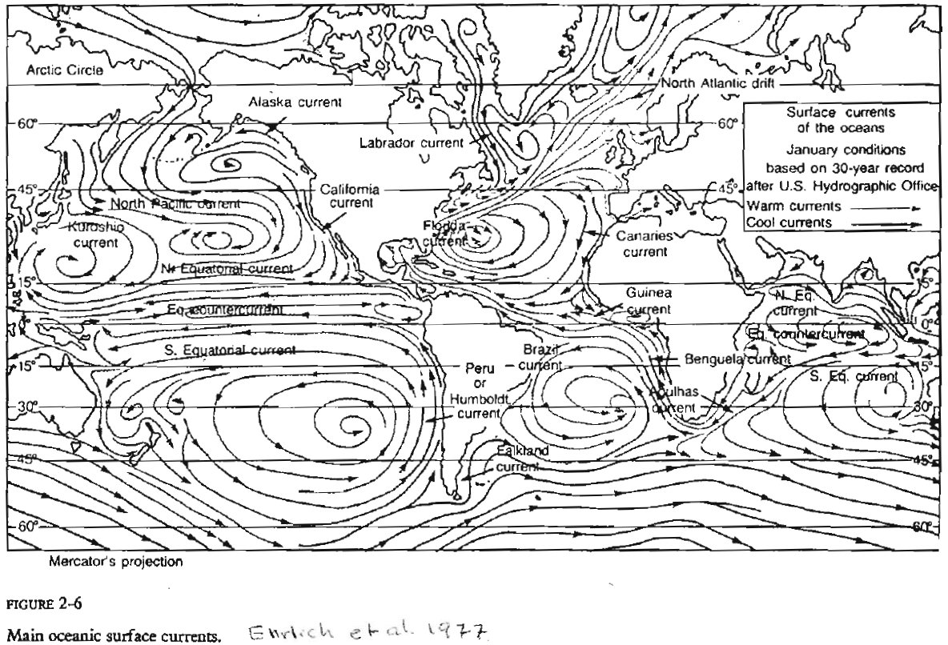
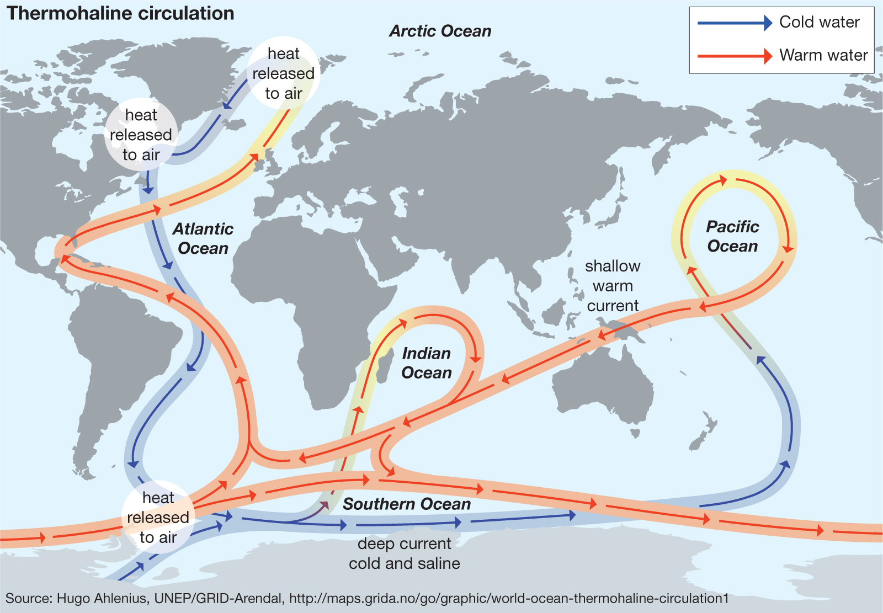
Ocean Circulation
Surface currents
Deep water circulation

Slide 20
Surface currents
Factors creating ocean gyres
Coriolis Effect

Slide 21
Latitudinal differences in rotational speed
N
60 º
835 km/hr
30 º
1446 km/hr
0 º
1670 km/hr
30 º
1 km = 0.6214 miles (1038 mph @ Equator)

Slide 22
Earth rotates out from under objects in motion over its surface creating a curved path for observers on the surface.
Northern Hemisphere
Southern Hemisphere

Slide 25
Deep water circulation
“Atlantic Conveyor”
AMOC – Atlantic Meridional Overturning Circulation
Thermohaline Circulation

Slide 26
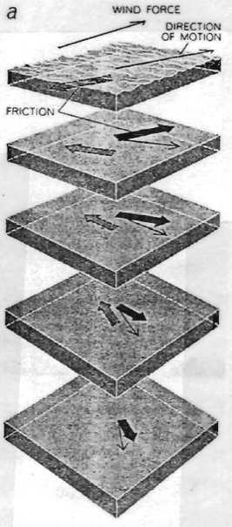
Upwelling & Ekman Drift
Ekman Spiral

Slide 27
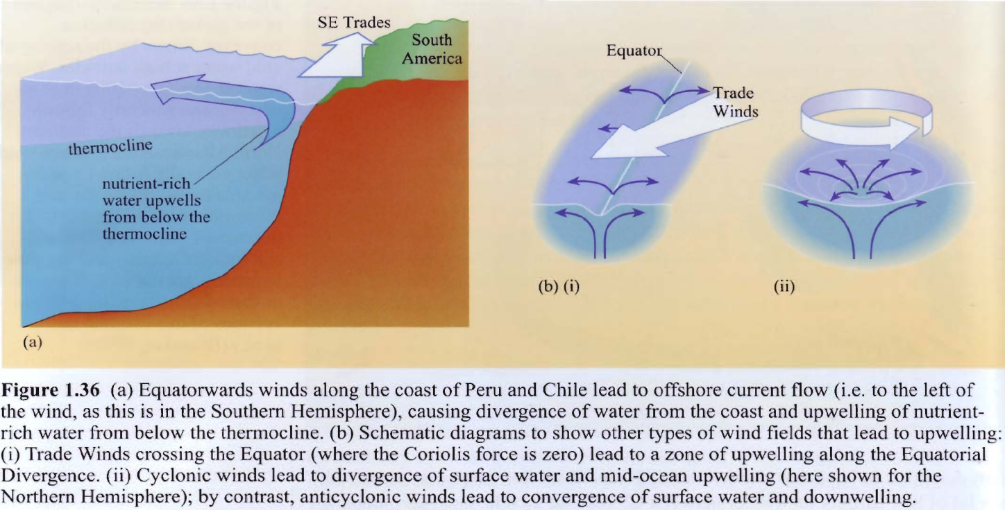
Cockell et al. 2007

Slide 28
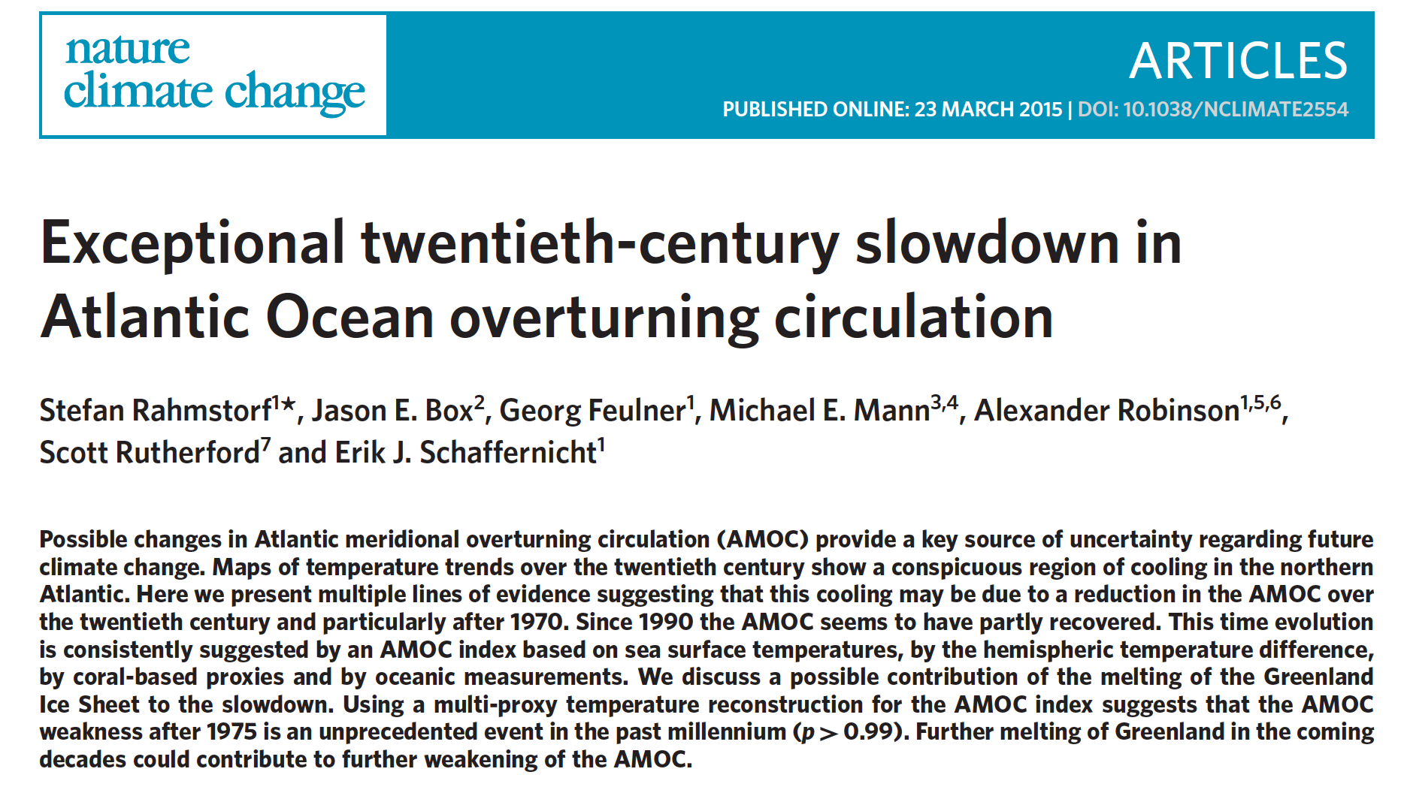
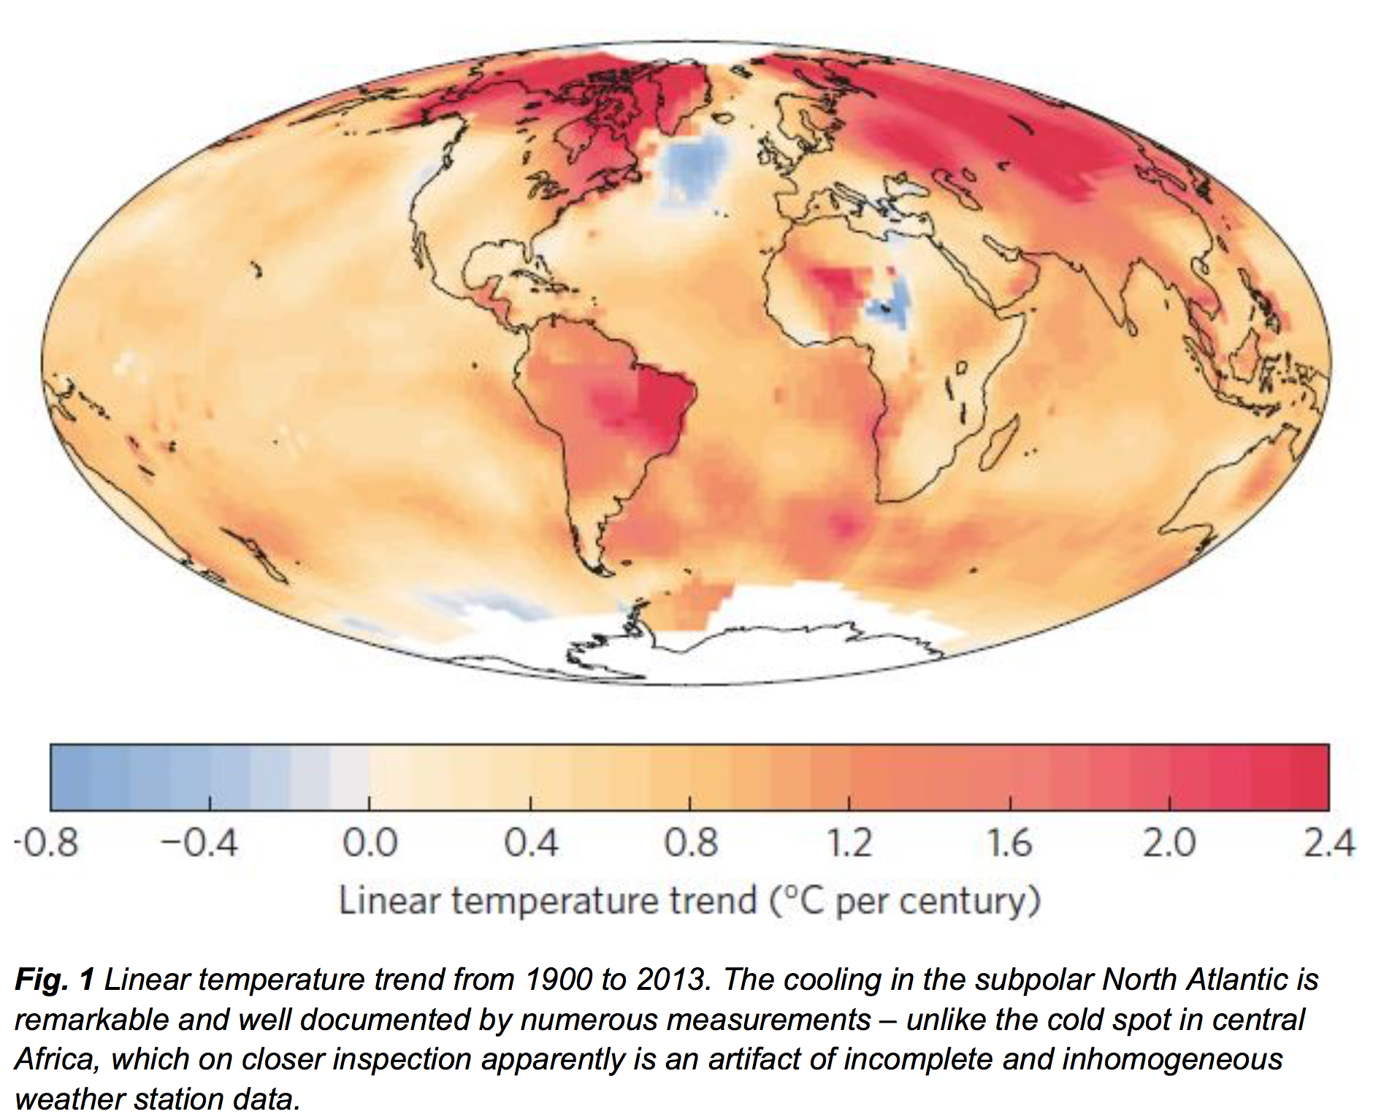
“Cold Blob”
“North Atlantic Warming Hole”

Slide 29
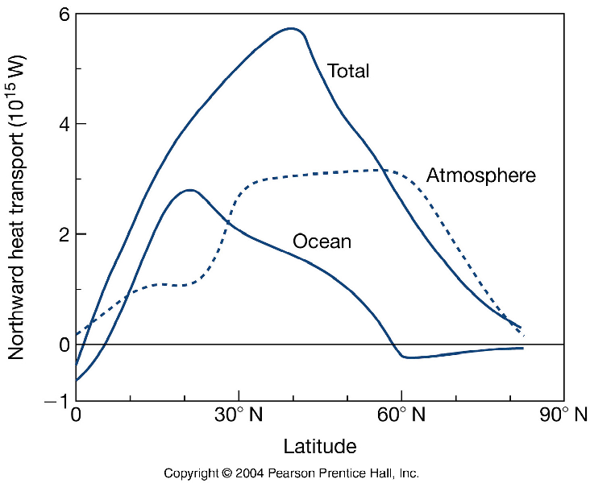
Kump et al. 2004
Rapid heat transport & anomalies quickly dissipate
Slow heat release & anomalies persist for long periods
Oort 1970

